Slide 1
Building new boxes

Slide 2

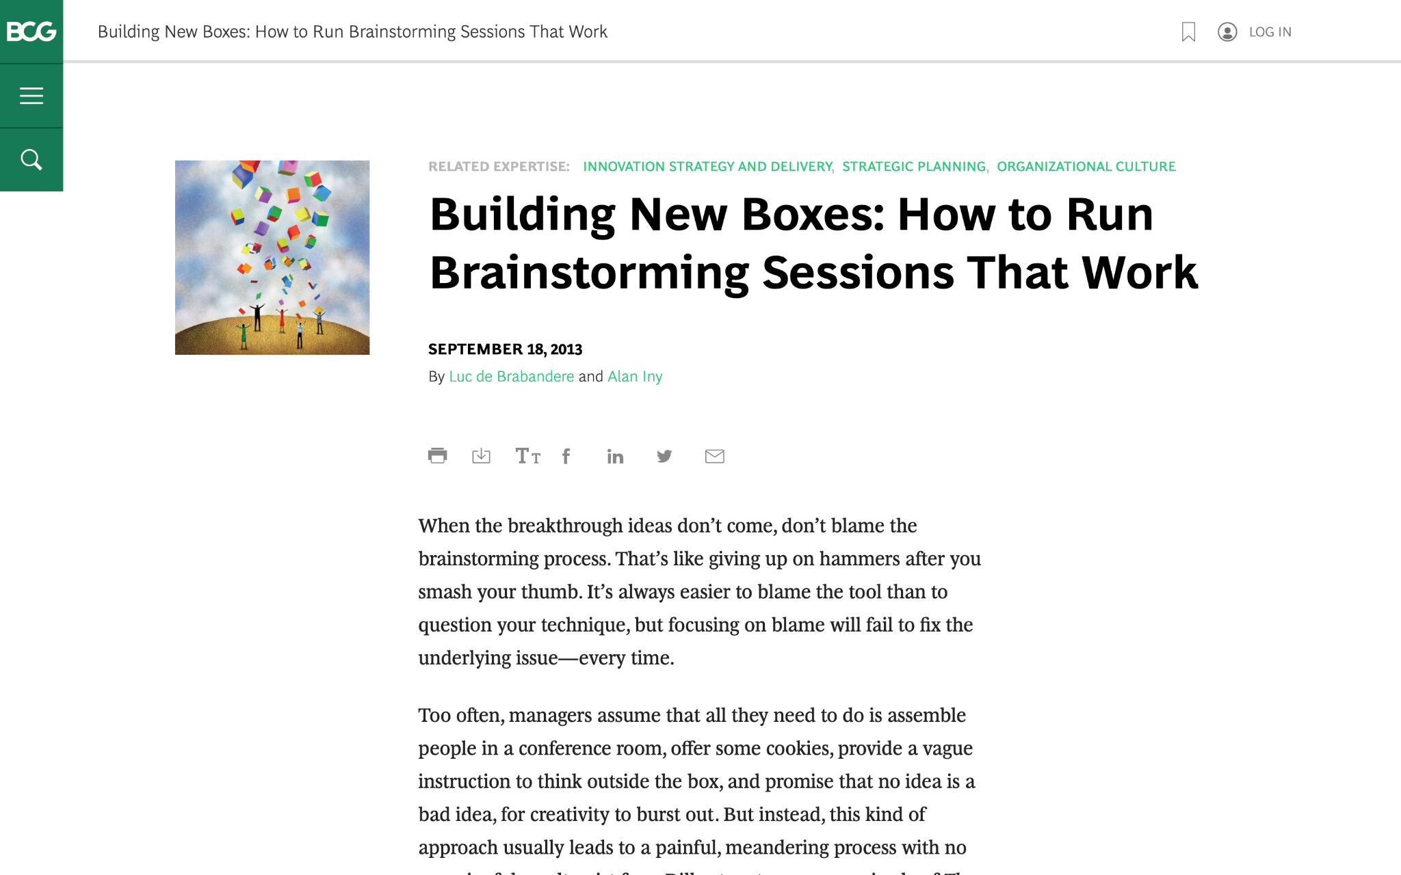
We are going to discuss effective brainstorming. Start by reviewing this article on the BCG website:
Building New Boxes: How to Run Brainstorming Sessions That Work

Slide 3

The article offers five suggestions to achieve real, valuable insights from brainstorming
We will focus on three of these in today’s task (as well as the brainstorming itself), highlighted in green
1.
Frame the question effectively
2.
Create creativity conditions
3.
Reveal and doubt your boxes
4.
Bring new boxes
5.
Follow up
Brainstorm

Slide 4

Your task
BCG has been brought in to help ClothingCo, a luxury clothing brand, grow their top line (i.e., increase revenue) after a period of declining sales.
The client is gearing up for the winter season. Imagine that you are a strategy consultant working on the project.
You will enter your responses in the green boxes throughout the remaining slides.

Slide 5
Frame the question effectively
Question to be reframed
How could we sell more outerwear this winter season?
–
Revised, effective questions:
What are the current trends in winter clothing that will increase our sales?
How can we create a social media buzz for our company?
How can we advertise our company/ product to be more visible?
–
Remember: A good question for brainstorming will be narrow and concrete, so that people feel they know how to begin answering it.
“If I were given one hour to save the planet, I would spend fifty-nine minutes defining the problem and one minute resolving it.”
– Albert Einstein

Slide 6
Reveal and doubt your boxes
In this fictional scenario, make assumptions that seem reasonable
–
What boxes currently exist that are still relevant?
Our products are trendy yet premium quality.
Our customers are mostly individuals between 20 and 40 years old
What boxes currently exist that need to be doubted?
Do we need to increase our price?
Should we expand to offline stores or stay exclusively online?
Do we need to increase our product range?
The first step in the creative process entails identifying and doubting one’s current boxes and determining which ones require re-evaluation or replacement.
Make a short list of the shared beliefs and assumptions that likely prevail in ClothingCo. Determine which are still relevant and which need to be redefined.

Slide 7
Bring new boxes
New box #1
Price increase leads to exclusivity
Reduce supply and increase demand (create scarcity).
Premium quality and pricing gives a sense of exclusivity.
Attracts a different demographic of individuals.
New box #2
Offline stores are a positive way to expand business
Visiting stores gives a better shopping experience.
Likely to attract new customers that pass by stores.
Explore channels like Saks Fifth Avenue, Barneys New York.
Prepare for brainstorming by creating new boxes to bring to the session; new boxes will nurture ideation and can dramatically increase the odds of a useful result.
Remember: Defining new boxes requires a mixture of analysis and art. Boxes need to be grounded in fact. Different sectors will call for different inputs.

Slide 8
Brainstorm
Choose one of the effective questions you created on slide 5, and a new box from slide 7, and brainstorm potential ideas to address the question
Question | How can we advertise our company/ product to be more visible?
New box | Offline stores are a positive way to expand business
Provide exclusive discounts for purchases in store.
Allow customizations in store.
Organise a small fashion show at the store.
Organise events or pop-up stores to attract new customers.
Collaborate with influencers to try your products.
Upload content related to events at the offline store.

